Slide 1

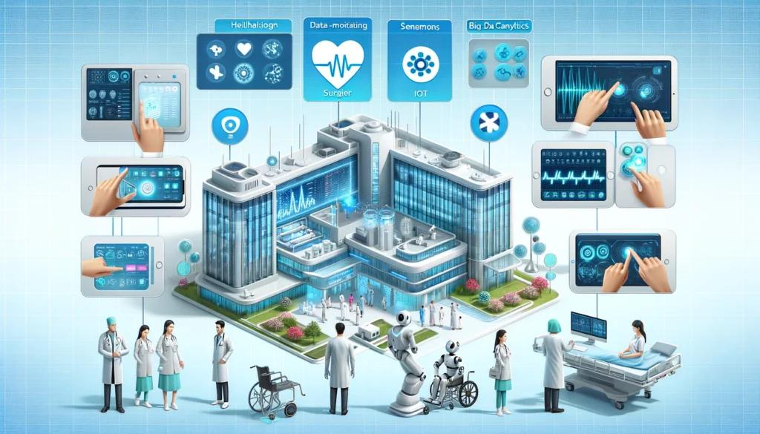
Object-Oriented Design in Smart Healthcare Systems
Technical Presentation
CSA1104 : Object oriented analysis and design
Presented by: Niranjana A
Faculty name: Dr.A.Gayathri

Slide 2
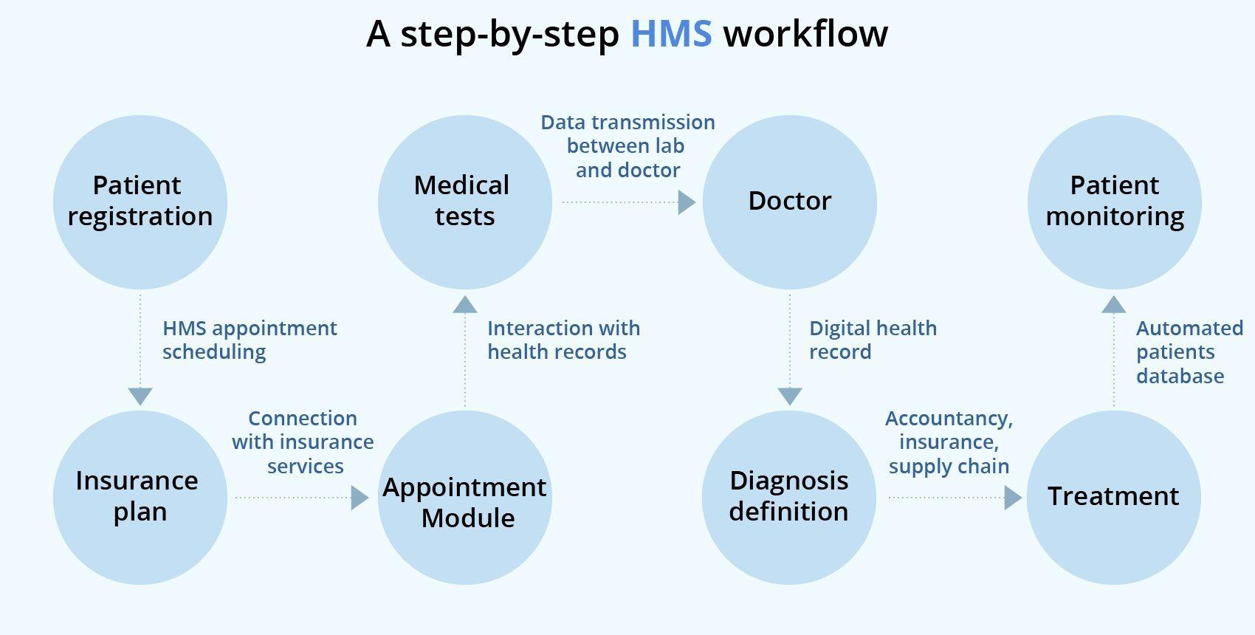
Introduction
What is a Smart Healthcare System?
A Smart Healthcare System is a digital platform that manages healthcare services efficiently using software technologies.
Main Components:
Patient Management
Doctor Management
Appointment Scheduling
Medical Records
Billing and Reports
Why Use OOP?
Organizes code into reusable objects
Simplifies software development
Makes applications secure and scalable

Slide 3
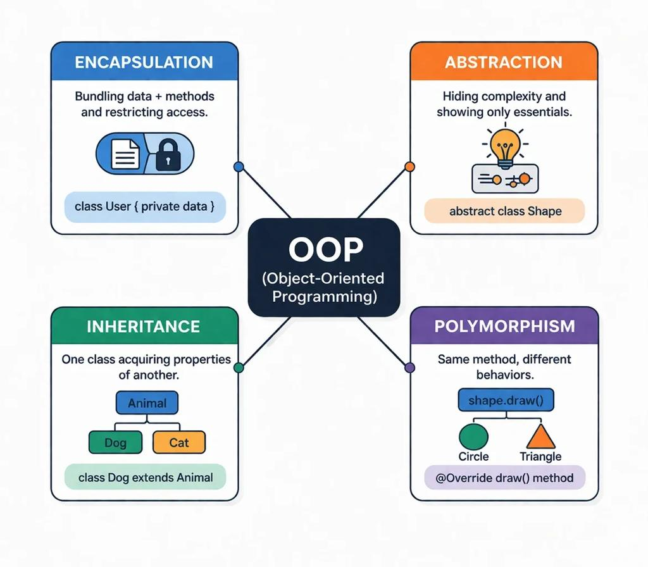
OOP concepts in smart health care
Class
Blueprint for creating objects.
Examples: Patient, Doctor, Appointment, MedicalRecord.
Object
Real instance of a class.
Example: Patient "John", Doctor "Dr. Smith".
Encapsulation
Protects sensitive data.
Example: Medical records and passwords.
Inheritance
Shares common features.
Example: Person → Doctor, Patient.
Polymorphism
Same method, different behavior.
Example: displayInfo() shows different details for Patient and Doctor.

Slide 4
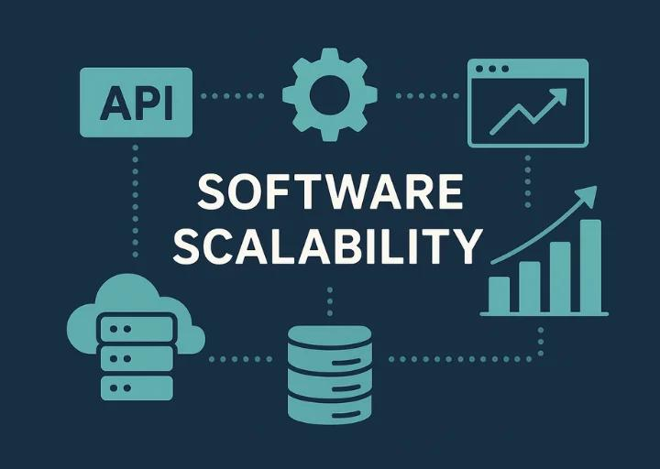
Benefits of OOP in smart health care
OOP Concept | Benefit
Encapsulation | Protects patient data
Inheritance | Reuses existing code
Polymorphism | Makes software flexible
Classes & Objects | Easy system organization
Improves:
✅ Scalability
Easily add new modules
Add new user types
✅ Security
Protect confidential medical records
✅ Maintainability
Easy to update and fix software

Slide 5
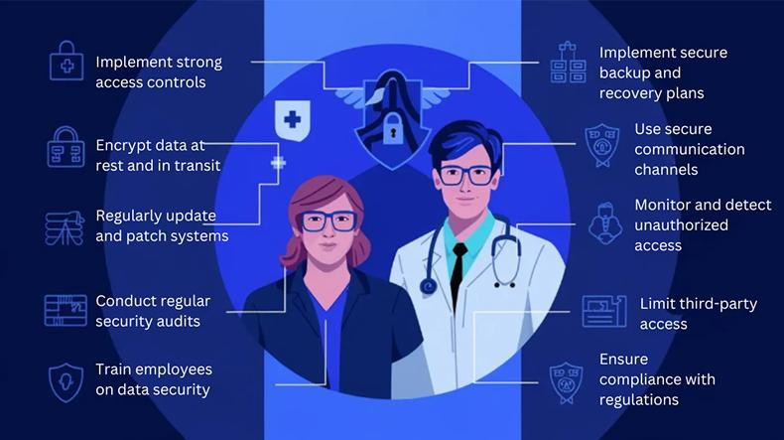
Real world applications
👨‍⚕️ Patient Management – Stores patient details and medical history.
🩺 Doctor Management – Manages doctor profiles and schedules.
📅 Appointment System – Books and tracks appointments.
📋 Medical Records – Securely stores diagnosis and treatment details.
💊 Prescription Management – Generates and updates prescriptions.
Outcome
Faster healthcare services
Improved data security
Easy system expansion
Better patient care

Slide 6
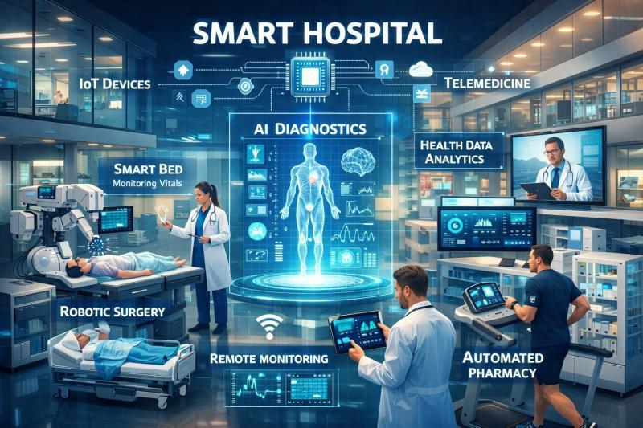
Conclusion
Summary
Object-Oriented Programming provides an efficient way to build Smart Healthcare Systems by:
Organizing data using classes and objects
Protecting patient information through encapsulation
Reusing code with inheritance
Supporting flexibility using polymorphism
Final Statement
OOP creates healthcare software that is scalable, secure, maintainable, and easy to expand for future medical technologies.

Slide 7


Thank You ☺

